Slide 2

Hamster Helper - Small Solutions for Big Problems

Slide 3
Problem
Best Buy has over thousands of products per store; it’s difficult for customers to find what they want.
This lowers customer satisfaction.

Slide 4
R = .81
Positive correlation between customer satisfaction and long term customer retention. Source: Temkin Group

Slide 5

Your first Blue Shirt will be your last Blue Shirt of the day.

Slide 6
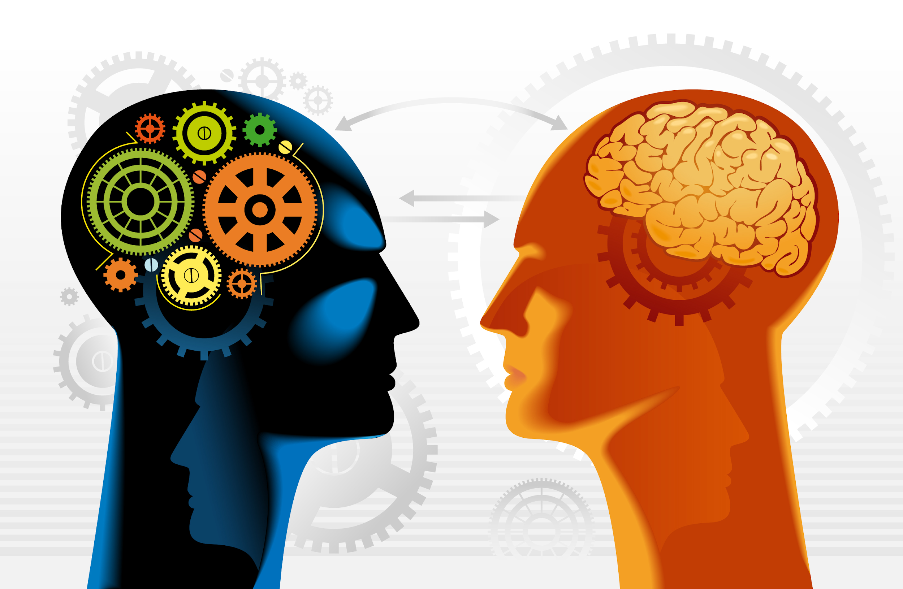
Solution
Use Machine Learning to categorize customers so Blueshirts can personalize their approach.

Slide 7
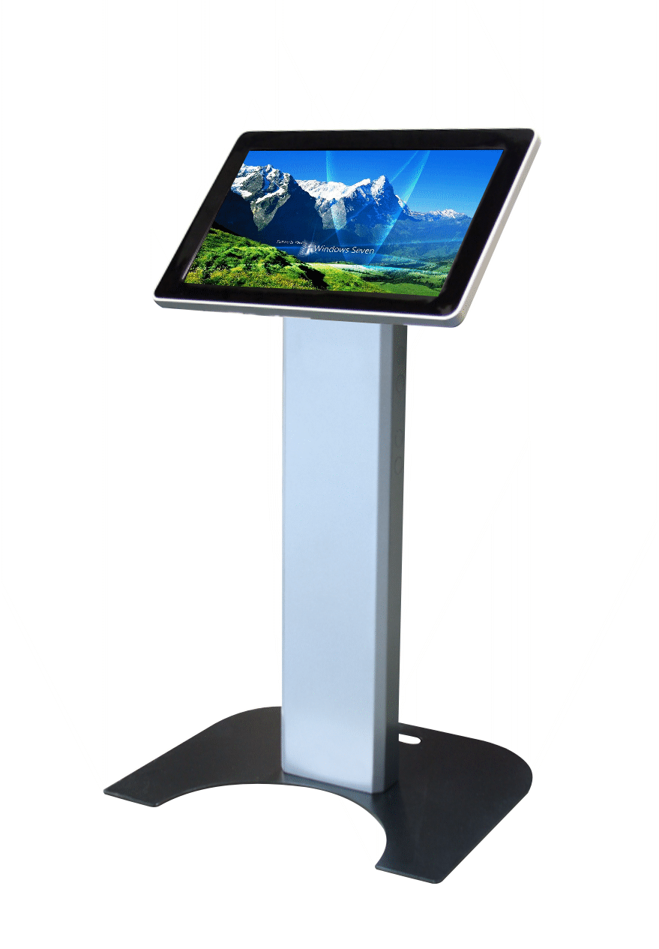
Customers
Greeting stations powered by Machine Learning allow customers to search by voice and touch input

Slide 8
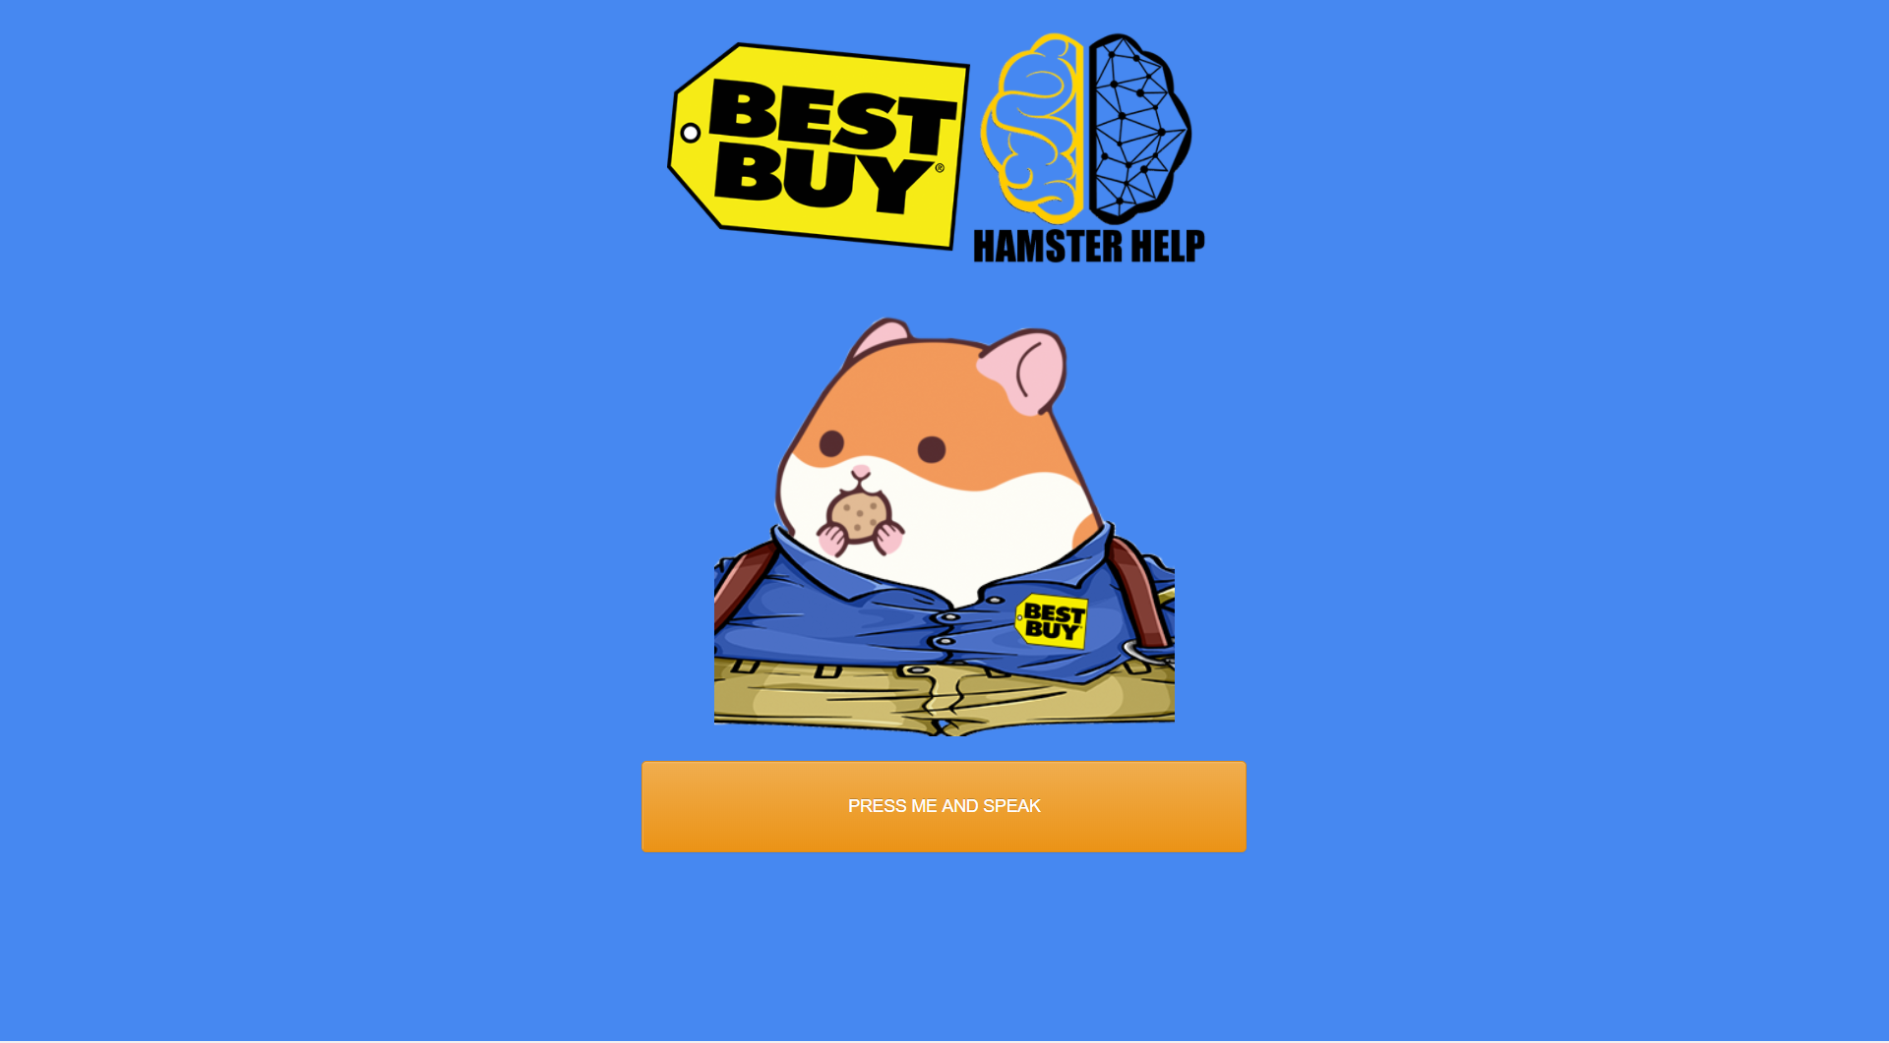
Interface

Slide 9
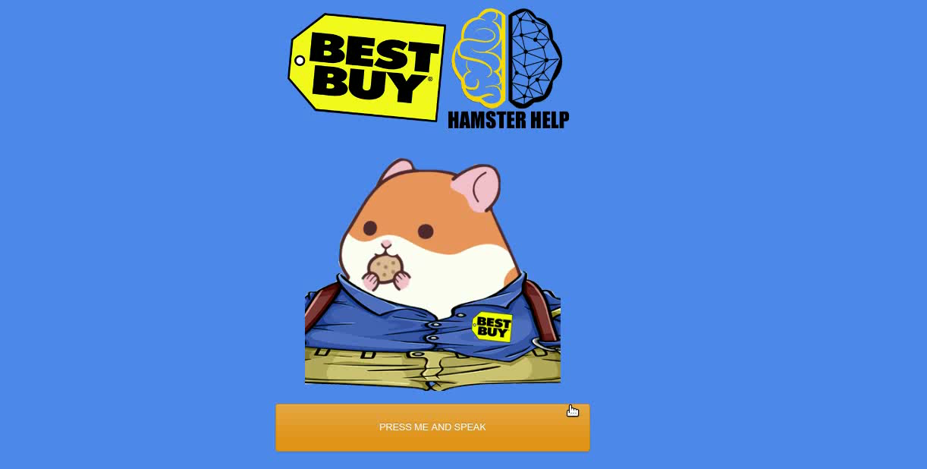
Interface

Slide 10
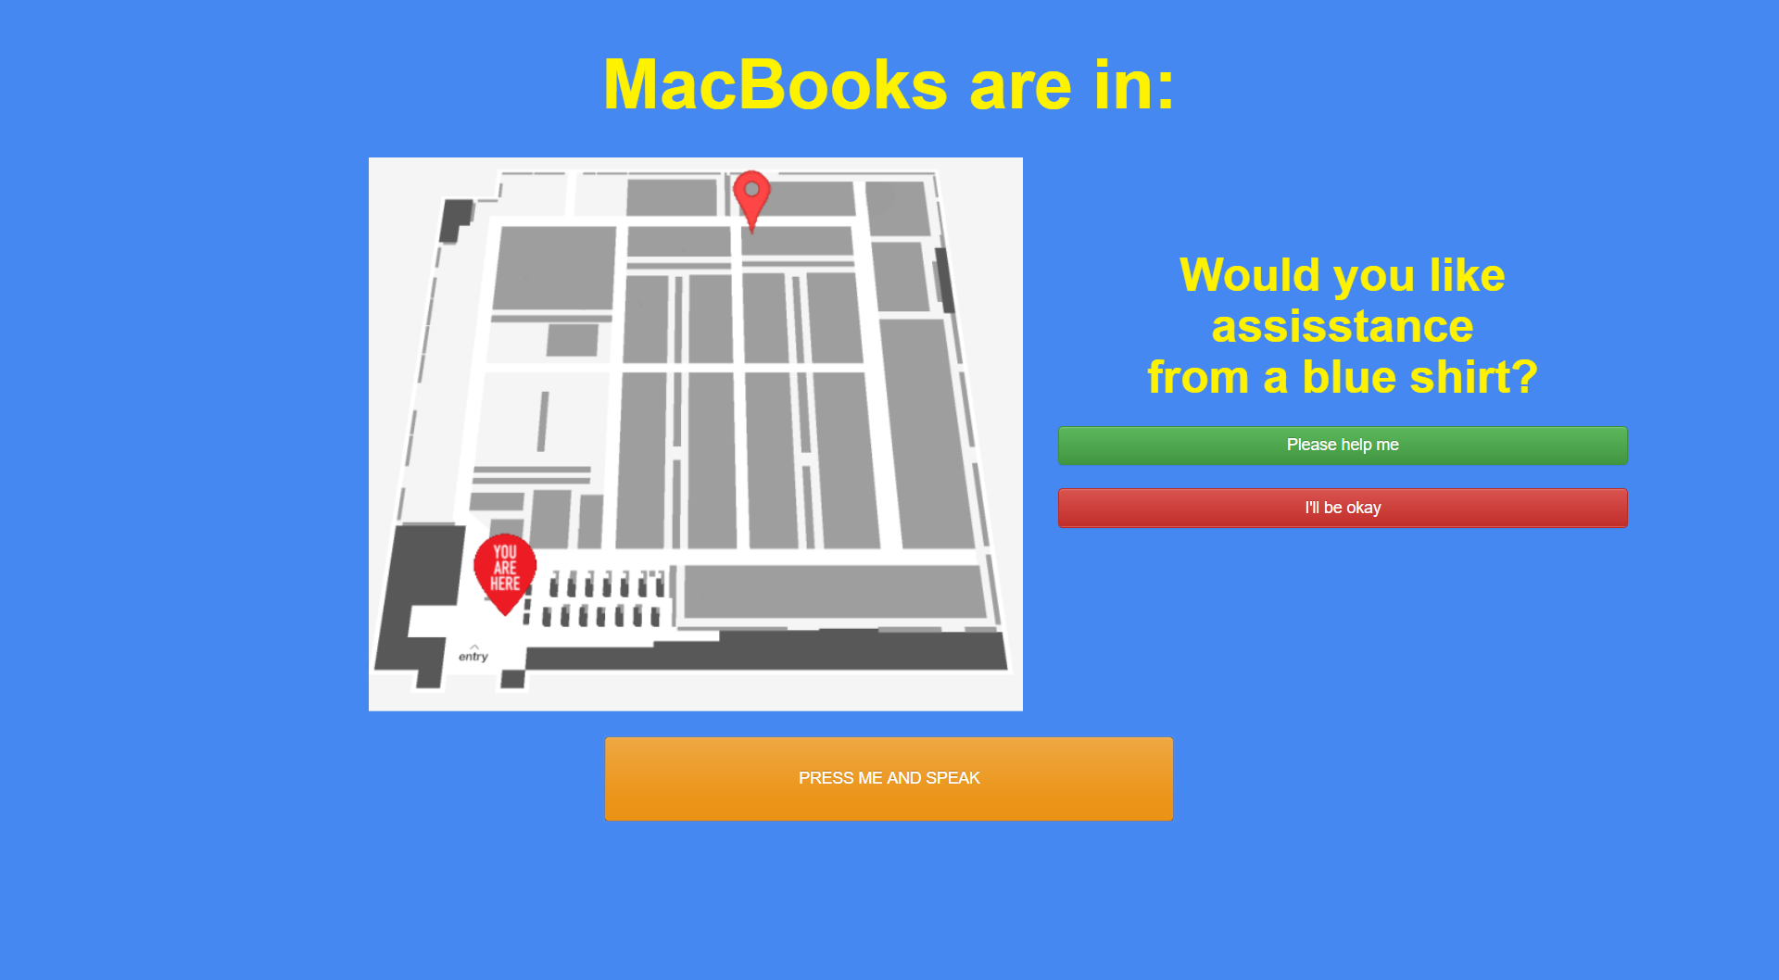
Interface

Slide 11

Interface

Slide 12
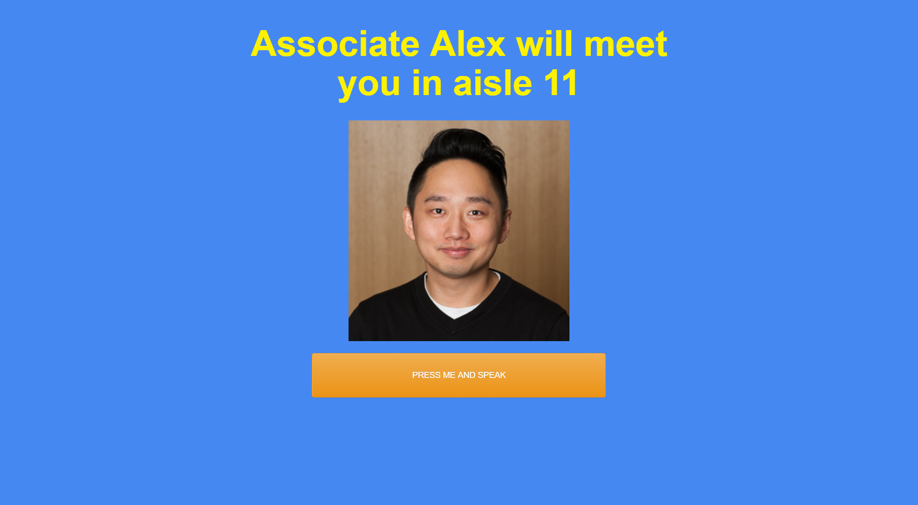
Interface

Slide 13

Employees
Blueshirts are notified with detailed customer information allowing them to be more knowledgeable in helping the customer
Notes:
Who can help, who to help, how they can help

Slide 14
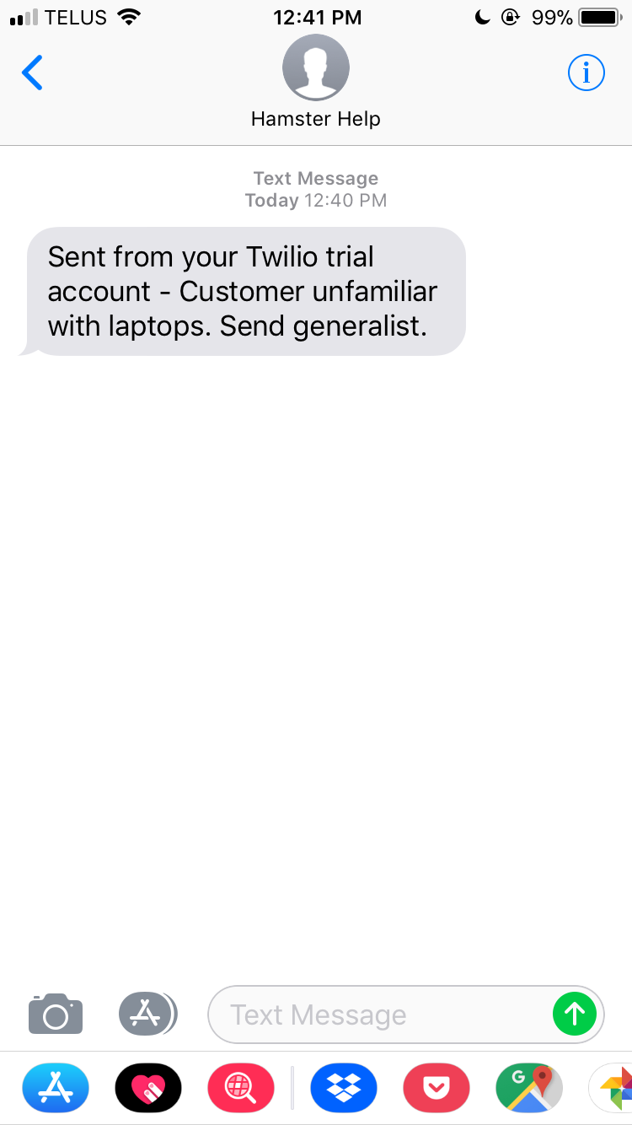
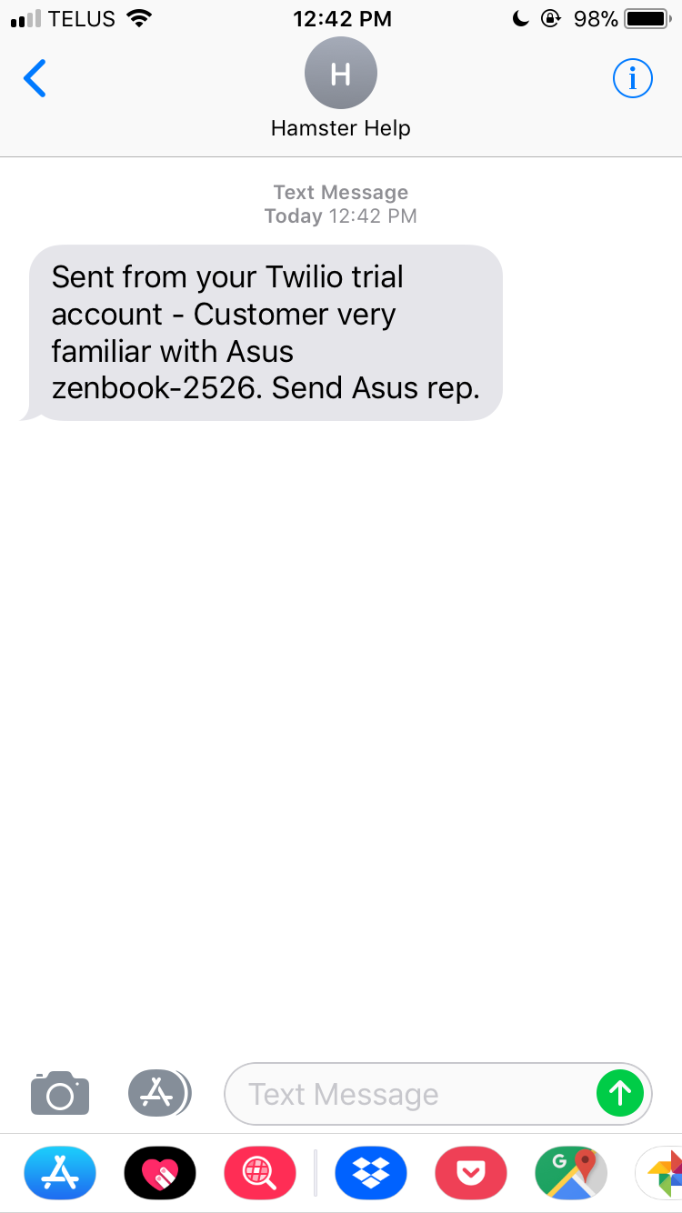
Employee Notification
Generalist: Specialist:

Slide 15
This will help Best Buy to increase customer satisfaction.

Slide 16
This creates instant value for the customer and the employee.
Notes:
Customer Value = time saved, right product, customer service
Employee value = challenged at the right level, provide information to readily support customer

Slide 17
Why Does This Work?
Shortens the time for customers to find their desired product, enhancing their experience
Enables Blueshirts to personalize suggestions and maximize their productivity.

Slide 18
A satisfied customer is the best business strategy of all.
Michael LeBoeuf

Slide 19
Thanks!

